Slide 1
Tertiary teaching online: pedagogy and practice
How to be an effective, engaging teacher in the online space
How to ensure learners are ready for online learning
Ali Hughes, TANZ eCampus
Notes:
1

Slide 2
GENDER
6,480 learners
76 NZQA courses
900+ course occurrences, L3-6
Condensed 10-week
AGE
TANZ eCAMPUS
ETHNICITY
LEVEL
Notes:
Non-traditional learners
Older, some in work,
some stay at home parents,
often first in family, lower socio-economic,
Often second chance learners- no positive experience of education, little or no formal quals
Have a lack of confidence, often whakama about seeking support
Scary experience-academic world is all new to them
Often personal situation throws up logistical challenges
Financial situation, lack of whānau support., time management often biggest barriers to success
2

Slide 3
Expectations
LEARNERS | INSTITUTIONS
Responsibility
Teachers -guide and motivate students to learn through engaging activities and varied pedagogical approaches. | Students - independent learners who are self-motivated and actively seek out help if they need it.
Instructor Presence and Course Materials
Varied course materials will be used to deliver content | Course content will be delivered mostly through text-based materials and asynchronous discussion boards.
Instructors - an active presence in the online environment and express “caring” through accessibility and time invested in the course. | Instructors will play the role of “content manager” and “guide on the side.”
Communication, Feedback, and Guidelines
Instructors - provide quick feedback via discussion board or email, including over the weekend. | Instructors will not be “on call,” particularly over the weekend.
Instructors - provide explicit information about assignments and exams, clear grading rubrics, and detailed feedback on graded assignments | If students want more help, information, or feedback on assignments, they will seek it out
CCRC Columbia University, Creating an effective online presence, March 2013
Notes:
Online education can be perceived as a cheap, low-quality alternative to face-to-face learning; however this is not what learners are expecting.
Disconnect between what learners think they will experience and what institutions are expecting to deliver
It is our challenge to meet their expectations
3

Slide 4
Role of the Facilitator
Supports learners
Guides them through their studies
Encourages participation
Motivates and encourages
Uses own experience to help grow learners’ knowledge
NOT THE SAGE ON THE STAGE
Notes:
What is a facilitator?
In this context a facilitator is an experienced person who supports learners during online courses. A facilitator will encourage conversation, ensuring that all learners are able to contribute and communicate in a positive and collaborative way.
The roles and responsibilities of a facilitator will vary from relatively simple tasks, such as encouraging participation in the online conversation, right through to supporting learners’ reflection on their learning.
Facilitators are tasked with promoting social learning opportunities, engaging with the learners to pose open questions, threading together discussions and moving the discussion forward to develop and deepen the learners’ learning and social learning skills.
4

Slide 5
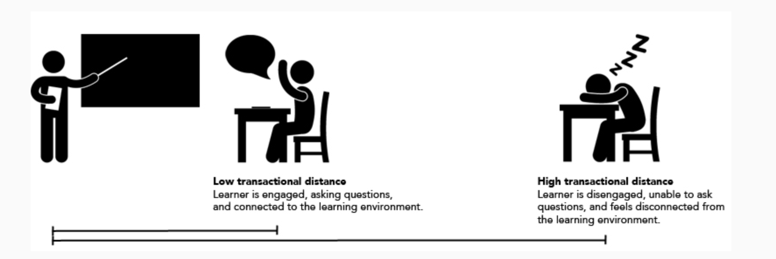
The challenges of transactional distance
Notes:
Transactional distance is the collection of perceived psychological, cognitive, and affective distances between learners and instructors in distance learning environments. It refers to the extent to which time and distance impact communications and interactions in a virtual learning environment
Even in face-to-face teaching there is some element of transactional distance (Rumble 1986). However this increases significantly when education is on-line. Particulary important for Māori and Pasifika learners
5

Slide 6
Establishing a facilitator presence
Teaching
Social
Cognitive
Facilitating, direct instruction, extending learning, assessing work
Being connected and interacting with other human beings as “real people”
Focusing on learning, knowledge acquisition and application
Notes:
Teaching Presence
It is what you do "in the moment" when interacting with your students, including the facilitation of discourse and direct instruction.
Direct instruction is the more straightforward of the two and would include pre-developed presentations, assessing student work and providing instructive feedback, diagnosing misconceptions, clarifying concepts, and referring students to additional resources or practice opportunities.
Social Presence
Important especially at the beginning of the course when students are getting to know and trust both you and one another. If students can make interpersonal connections with others, they are more likely to engage with the course and the content. Indicators of Social Presence include
Affective responses such as expressing emotion and using humour
Interactive responses such as continuing a discussion thread, referring to other students in a message or post, asking questions, and expressing agreement or appreciations
Cohesive responses such as using other students' names, using inclusive pronouns to refer to their group or class, and engaging in small talk
Cognitive presence is central to successful student learning. The quality of cognitive presence reflects the quality and quantity of critical thinking, collaborative problem-solving, and construction of meaning occurring interactions. You can model and support cognitive presence in your interactions with students in discussions, assignment feedback, and other communications.
6

Slide 7
Regular communication
Three postings per week
Set the scene
Add to knowledge gained
Wrap-up and look forward
Share your knowledge
Give real life examples
Share stories
Photo by bongkarn thanyakij
Personalise the learning
Building effective communication
Share your personality
Encourage dialogue with and between learners
Notes:
7

Slide 8
Building learning
Weekly activities to engage learners, build understanding and monitor learner progress
Assessment formats which are engaging, collaborative and support learners to make human connections
Regular engagement in on-line forums designed to spark conversations and new thinking
SCAFFOLDING THE LEARNING
Notes:
8

Slide 9
The process of establishing links, making connections and relating to the people one meets by identifying in culturally appropriate ways,
Sharing points of engagement, or other relationships.
DEVELOPING RELATIONSHIPS
Whakawhanaungatanga
Notes:
When you make the effort to do all you do to support the learners in their academic endeavours and ensure they feel a sense of belonging the learners are more likely to persevere in their students and complete their qualification (Sister Mary Rose)
9

Slide 10
Learners need to see themselves
Culturally inclusive
Use of pepeha and whakatauki
Integrating te reo and tikanga Māori
Providing authentic learning contexts
Connecting culture and learning experiences
Context
Mā te kōrero, ka mōhio.
Mā te mōhio, ka mārama.
Mā te mārama, ka mātau.
Through discussion we become aware.
Through awareness we gain understanding.
Through understanding we gain proficiency/expertise
https://www.inclusive.tki.org.nz/guides/supporting-maori-students/
Notes:
10

Slide 11
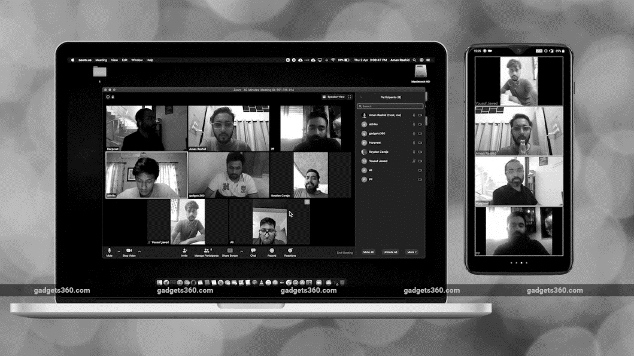
Building community
Communities of Practice
Online forums
Collaborative workspaces (e.g. One Note)
Use of group facilities e.g. Facebook messenger groups, SmartThinking groups
Zoom, Skype, MS Teams
CONNECTING LEARNERS
Notes:
11

Slide 12
Online support
Use of tools such as SmartThinking to help with assessment development and academic writing
Timely feedback
Assessed against clear marking rubrics
praising things they’re doing well
correcting their incorrect responses
Feedforward
Highlighting areas to work on
focusing on development for the future
Photo by Bakr Magrabi
Building learning
Notes:
12

Slide 13
Building good habits
Learning pathway
PLANNING & MONITORING
Dashboard
activity view
Detailed view
of activity
Assessments
Forum
activity
Notes:
13

Slide 14
What do learners need to be ready to study on-line?
Notes:
14

Slide 15
Photo by Burst
Photo by Free-Photos--242387
Photo by Startup Stock Photos
Technology
Time Management
Study Skills
Ensuring internet and computer availability
Planning the time and space to study
Report writing, referencing, mind maps, academic reading.
Preparing learners #1
Notes:
15

Slide 16
Photo by Burst
Photo by McElspeth
Photo by Darrel Und
Support
Set a long-term goal
Connect
Rally your crew, accept support, establish your study space
Know what you want to achieve- a new career, promotion, own business?
Connect with other learners- online, face to face, study dates
Preparing learners #2
Notes:
16

Slide 17
Te Whare Tapa Whā model for
on-line learners*
WRAPAROUND SUPPORT
*TANZ eCampus, modelled on Sir Mason Durie’s original model
Notes:
This is a holistic Māori health and wellbeing model designed to support Māori in a range of contexts. It is designed to provide a structure which frames the learning experience and supports the learners’ readiness to learn on-line.
te taha wairua (spiritual health) establishing good study habits, growing confidence, and belief that they can succeed- I can cope with the demands of the course
te taha tinana (physical health) technology and physical needs, understanding online learning
te taha whānau (family health) Focusing on relationships, building support networks, making connections with the facilitators and other learners- I have the support to do this course
te taha hinengaro (emotional and well-being health) preparedness to study, focussing on sense of achievement, using positive affirmations, helping manage stress and workload, celebrating success - I believe I can do this course
- I have the resources to do this course
17

Slide 18
Ko te manu e kai ana i te miro nōnā te ngahere,
ko te manu e kai ana i te mātauranga nōnā te ao.
The forest belongs to the bird who feasts on the miro berry,
the world belongs to the bird who feasts on education.
Learner Experience & Success Manager
TANZ eCampus
Mobile number: +64 21 764 553
Email : ali.hughes@tanzecampus.com
@alihug
CONTACT DETAILS
Ali Hughes
Notes:
18

