Slide 1
Data, Cognitive Science and Bespoke Education
Dr. Tristan Denley
Executive Vice Chancellor for Academic Affairs
and Chief Academic Officer
University System of Georgia
Tristan.Denley@usg.edu
Twitter: @TDenley

Slide 2
Creating Clear
Degree Pathways to Success

Slide 3
The Graduate Transcript Graph

Slide 4
The Graduate Transcript Graph

Slide 5
The Graduate Transcript Graph
MATH
ENGLISH

Slide 6
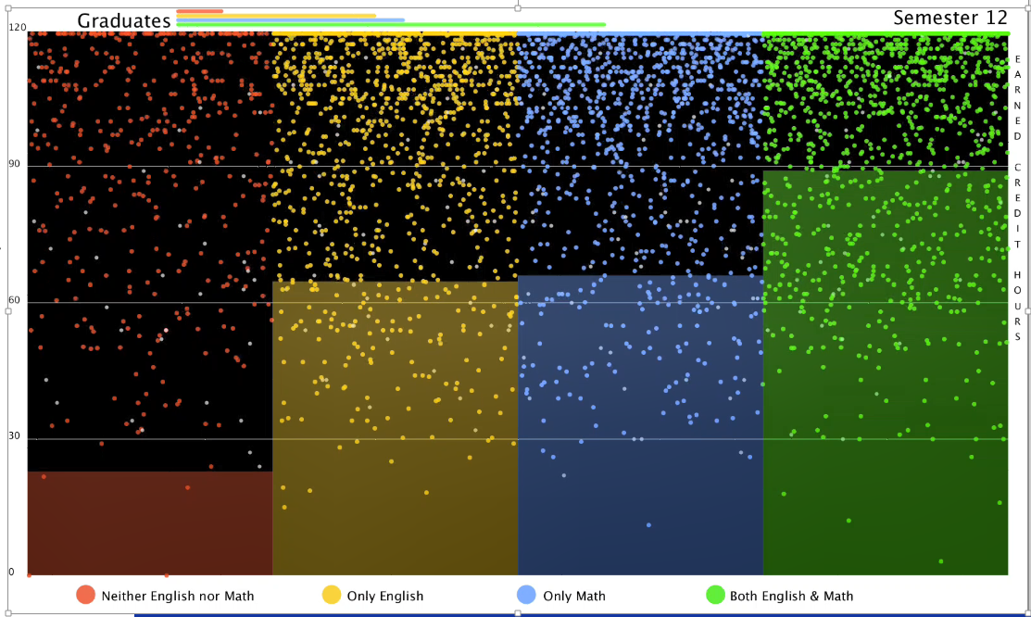
10,000 USG Students
2,500 who either completed their first credit bearing math and/or writing class or completed neither during their first academic year

Slide 7
English and M⍺𝜏h
1st yr - Did not pass English or Math
1st yr - Passed English
1st yr - Passed Math
1st yr - Passed both English and Math

Slide 8
English and M⍺𝜏h
Overall Pass rate
Passed English
Passed Math
Passed both English and Math
Graduation Rates
Engineering L3 Certificate

Slide 10
System-wide Math Completion for students beginning in Developmental Mathematics
ACT Math Subscores

Slide 11
System-wide Math Completion for students beginning in Developmental Mathematics
10 Standard Deviations
ACT Math Subscores

Slide 12
Completion of Gateway Math by ACT Sub-score Community College Pre-requisite Model vs. Co-requisite Model

Slide 13
USG System-wide Comparison of Success in Gateway Math Classes

Slide 14
System Comparison of Success in Gateway English Classes

Slide 15
Co-requisite
Disaggregation

Slide 16
USG System-wide Comparison of Success in Gateway Math Classes
Pell Students

Slide 17
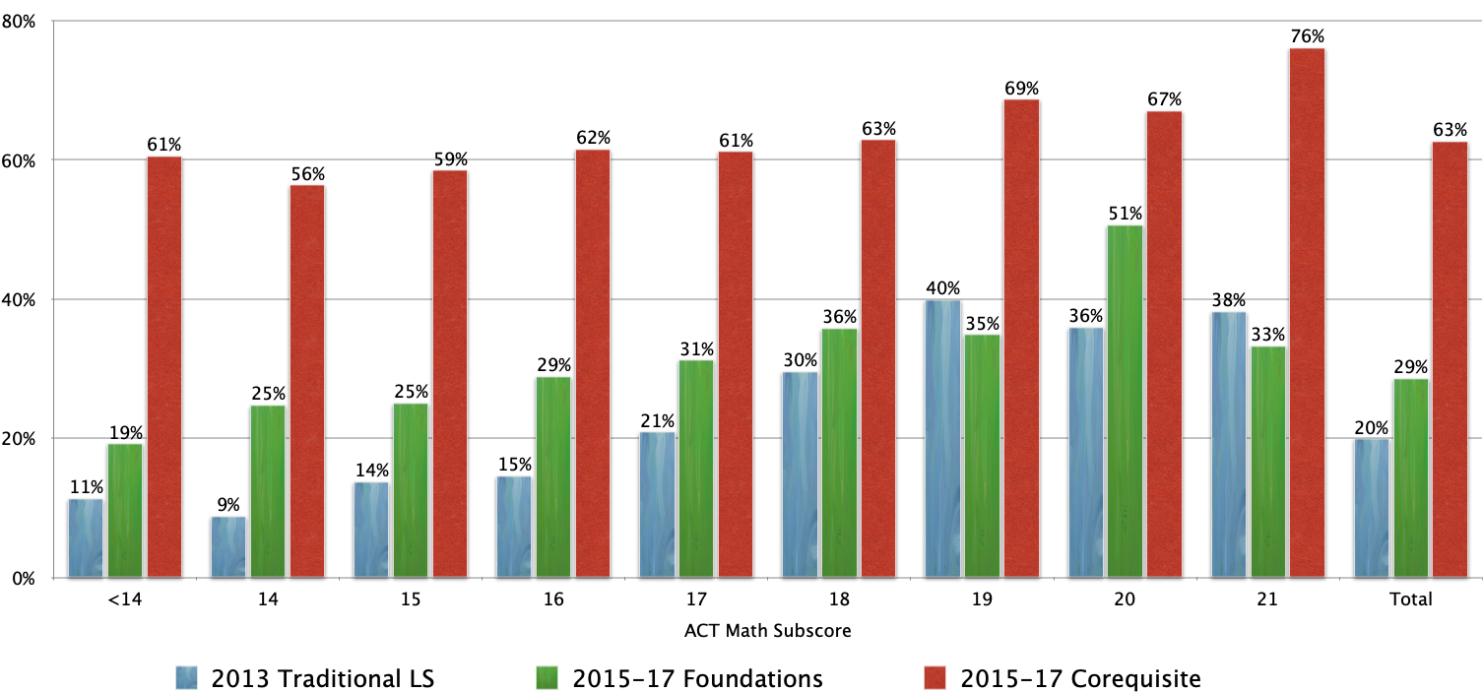
USG System-wide Comparison of Success in Gateway Math Classes
African American Students

Slide 18
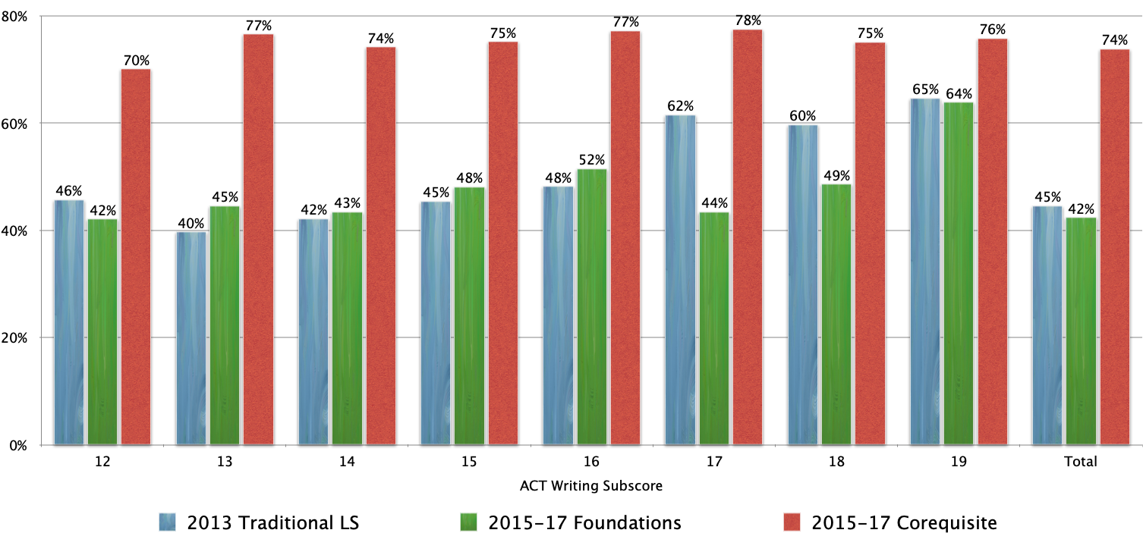
System Comparison of Success in Gateway English Classes
African American Students

Slide 19
74%
68%
59%
Enroll in
Foundations Math
Pass Foundations Math
Enroll in College Math
Pass College Math
29%

Slide 20
31%
63%
Enroll in
L3 Certificate
Pass L3 Certificate
Enroll in College Program
Pass College Program
20%

Slide 21
All Students
31%
63%
Enroll in
L3 Certificate
Pass L3 Certificate
Enroll in College Program
Pass College Program
20%
Maori Students
27%
51%
Enroll in
L3 Certificate
Pass L3 Certificate
Enroll in College Program
Pass College Program

Slide 22
Productive Academic Mindset
Perceived purpose of coursework
Feel connected to their institution
and that they belong…
Believe they are capable of learning the material…
Confidence interacting with Faculty and Staff
GRIT and Perseverance

Slide 23
System-wide success rates in Freshman CoReq English Classes

Slide 24
System-wide success rates in Freshman CoReq English Classes
African American Students

Slide 25
System-wide success rates in Freshman Mathematics Classes
“What I learn in Math will be useful in my career”
“What I learn in Math will not be useful in my career”
“What I learn in Math will not be useful in my future”
“What I learn in Math will not be useful to me at all”

Slide 26
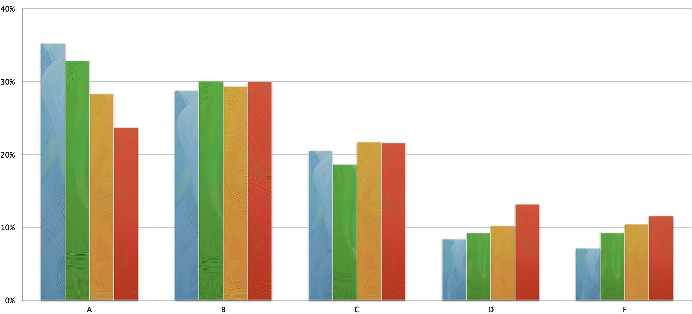
System-wide success rates in Freshman Mathematics Classes

Slide 27
System-wide success rates in Freshman Mathematics Classes

Slide 28
System-wide success rates in Freshman Mathematics Classes

Slide 29
System-wide success rates in Freshman Mathematics Classes

Slide 30
Health Professions
Science
& Math
Engineering
Humanities
Business
Arts
Social Sciences
Education

Slide 31
Leadership
Nature
Life
Service
Culture
Technology
Creative

Slide 32
The effect of course enrollments in the first year
on graduation rates
1st yr - Did not attempt 9hrs in focus area
1st yr - Attempted 9hrs in focus area
1st yr - Earned 9hrs in focus area

Slide 33
M⍺𝜏h
P⍺𝜏hω⍺ys

Slide 34
State University 6year Graduation Rates based on hours enrolled in First Semester

Slide 35
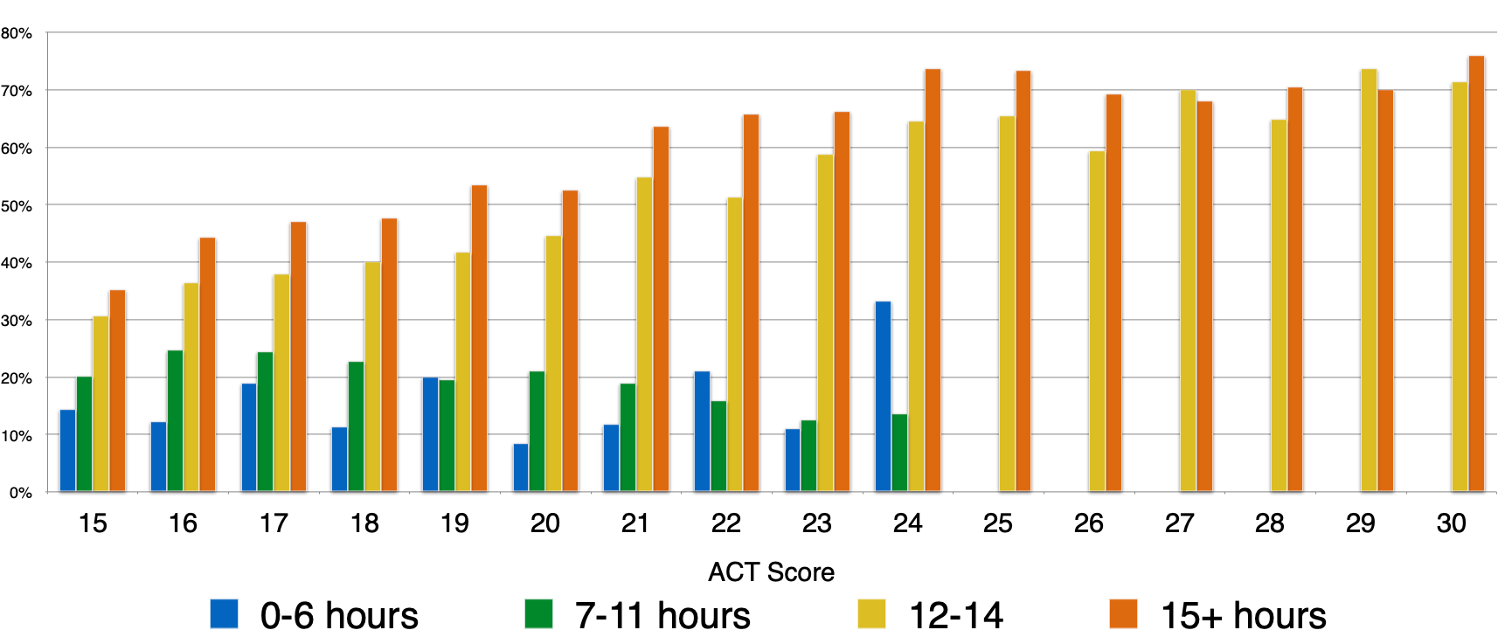
State University 6year Graduation Rates based on hours enrolled in First Semester
13%
22%
43%
54%

Slide 36
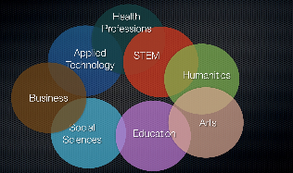
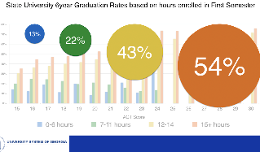
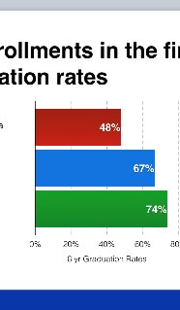
Momentum Year
Making a purposeful program choice
Creating a productive Academic Mindset
Attempting the first 30 hours of a Clear Pathway
Attempting 9 hours in Academic Focus
Complete initial English and M⍺𝜏h

Slide 37
Since 2013…
Community College
3yr Graduation Rate
University
4yr Graduation Rate
61%
26%

Slide 38
Since 2013…
Community College
3yr Graduation Rate
University
4yr Graduation Rate
93%
51%
Students of color

Slide 39
Dr. Tristan Denley
Executive Vice Chancellor for Academic Affairs
and Chief Academic Officer
University System of Georgia
Tristan.Denley@usg.edu
Twitter: @TDenley

